Slide 1



University Institute of Engineering
DEPARTMENT OF COMPUTER SCIENCE & ENGINEERING
Subject Name: Software Engineering
Subject Code: 23CST-206
Software Project Management
Er. Jagmeet Kaur
E8387
ASSISTANT PROFESSOR
CSE
DISCOVER . LEARN . EMPOWER

Slide 2
COCOMO Model
Boehm proposed COCOMO (Constructive Cost Estimation Model) in 1981.
COCOMO is one of the most generally used software estimation models in the world.
COCOMO predicts the efforts and schedule of a software product based on the size of the software.
Cocomo (Constructive Cost Model) is a regression model based on LOC, i.e number of Lines of Code.

Slide 3
COCOMO Model
It is a procedural cost estimate model for software projects and often used as a process of reliably predicting the various parameters associated with making a project such as size, effort, cost, time and quality.

Slide 4
COCOMO Model
The key parameters which define the quality of any software products, which are also an outcome of the Cocomo are primarily Effort & Schedule:
Effort: Amount of labor that will be required to complete a task. It is measured in person-months units.
Schedule: Simply means the amount of time required for the completion of the job, which is, of course, proportional to the effort put. It is measured in the units of time such as weeks, months.

Slide 5
COCOMO Model
Different models of Cocomo have been proposed to predict the cost estimation at different levels, based on the amount of accuracy and correctness required.
All of these models can be applied to a variety of projects, whose characteristics determine the value of constant to be used in subsequent calculations.

Slide 6
COCOMO Model
Boehm’s definition of organic, semidetached, and embedded systems:
Organic – A software project is said to be an organic type if the team size required is adequately small, the problem is well understood and has been solved in the past and also the team members have a nominal experience regarding the problem.
Embedded – A software project with requiring the highest level of complexity, creativity, and experience requirement fall under this category. Such software requires a larger team size than the other two models and also the developers need to be sufficiently experienced and creative to develop such complex models.

Slide 7
COCOMO Model
Semi-detached – A software project is said to be a Semi-detached type if the vital characteristics such as team-size, experience, knowledge of the various programming environment lie in between that of organic and Embedded.
The projects classified as Semi-Detached are comparatively less familiar and difficult to develop compared to the organic ones and require more experience and better guidance and creativity.
Eg: Compilers or different Embedded Systems can be considered of Semi-Detached type.

Slide 8
COCOMO Model
Types of Models: COCOMO consists of a hierarchy of three increasingly detailed and accurate forms. Any of the three forms can be adopted according to our requirements. These are types of COCOMO model:
Basic COCOMO Model
Intermediate COCOMO Model
Detailed COCOMO Model

Slide 9
COCOMO Model
The first level, Basic COCOMO can be used for quick and slightly rough calculations of Software Costs. Its accuracy is somewhat restricted due to the absence of sufficient factor considerations.
Intermediate COCOMO takes these Cost Drivers into account and Detailed COCOMO additionally accounts for the influence of individual project phases, i.e in case of Detailed it accounts for both these cost drivers and also calculations are performed phase wise henceforth producing a more accurate result. These two models are further discussed below.

Slide 10
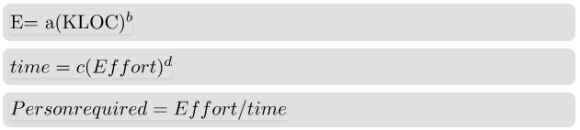
Estimation of Effort: Calculations
The above formula is used for the cost estimation of for the basic COCOMO model, and also is used in the subsequent models.

Slide 11
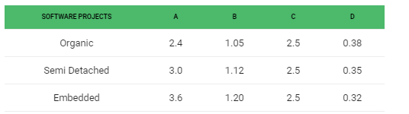
Estimation of Effort: Calculations
The constant values a,b,c and d for the Basic Model for the different categories of system:

Slide 12
Estimation of Effort: Calculations
The effort is measured in Person-Months and as evident from the formula is dependent on Kilo-Lines of code. The development time is measured in Months.
These formulas are used as such in the Basic Model calculations, as not much consideration of different factors such as reliability, expertise is taken into account, henceforth the estimate is rough.

Slide 13
Intermediate Model
The basic Cocomo model assumes that the effort is only a function of the number of lines of code and some constants evaluated according to the different software system.
However, in reality, no system’s effort and schedule can be solely calculated on the basis of Lines of Code. For that, various other factors such as reliability, experience, Capability. These factors are known as Cost Drivers and the Intermediate Model utilizes 15 such drivers for cost estimation.

Slide 14
Classification of Cost Drivers and their attributes:
(i) Product attributes –
Required software reliability extent
Size of the application database
The complexity of the product
(ii) Hardware attributes –
Run-time performance constraints
Memory constraints
The volatility of the virtual machine environment
Required turnabout time

Slide 15
Classification of Cost Drivers and their attributes:
(iii) Personnel attributes –
Analyst capability
Software engineering capability
Applications experience
Virtual machine experience
Programming language experience
(iv) Project attributes –
Use of software tools
Application of software engineering methods
Required development schedule

Slide 16
Intermediate Model
The Intermediate COCOMO formula now takes the form:

Slide 17
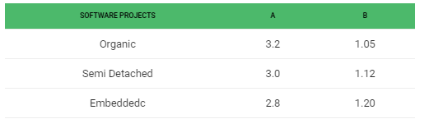
Intermediate Model
The values of a and b in case of the intermediate model are as follows:

Slide 18
Detailed Model
Detailed COCOMO incorporates all characteristics of the intermediate version with an assessment of the cost driver’s impact on each step of the software engineering process.
The detailed model uses different effort multipliers for each cost driver attribute. In detailed cocomo, the whole software is divided into different modules and then we apply COCOMO in different modules to estimate effort and then sum the effort.

Slide 19
Detailed Model
The Six phases of detailed COCOMO are:
Planning and requirements
System design
Detailed design
Module code and test
Integration and test
Cost Constructive model
The effort is calculated as a function of program size and a set of cost drivers are given according to each phase of the software lifecycle.

Slide 20
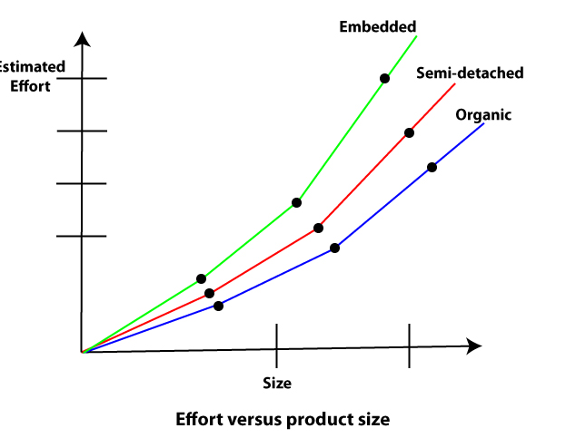
Effort Vs Product Size
In different cocomo models, the effort required to develop a product increases very rapidly with project size.

Slide 21
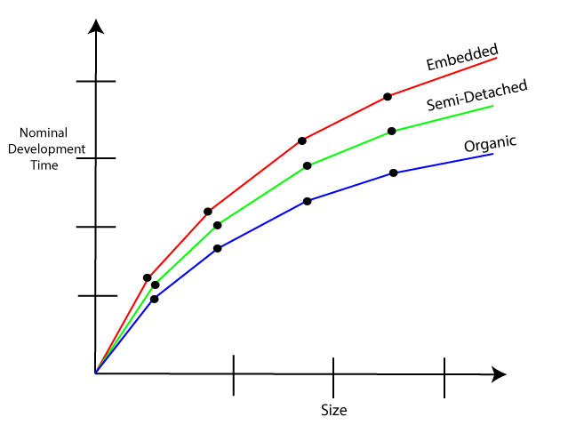
Development Time Vs Size
When the size of the product increases by two times, the time to develop the product does not double but rises moderately. This can be explained by the fact that for larger products, a larger number of activities which can be carried out concurrently can be identified.

Slide 22
Examples
Example1: Suppose a project was estimated to be 400 KLOC. Calculate the effort and development time for each of the three model i.e., organic, semi-detached & embedded.
Solution: The basic COCOMO equation takes the form:
Effort=a₁*(KLOC) a₂ PM Tdev=b₁*(efforts)b₂ Months Estimated Size of project= 400 KLOC
(i)Organic Mode
E = 2.4 * (400)1.05 = 1295.31 PM D = 2.5 * (1295.31)0.38=38.07 PM

Slide 23
Examples
(ii)Semidetached Mode
E = 3.0 * (400)1.12=2462.79 PM D = 2.5 * (2462.79)0.35=38.45 PM
(iii) Embedded Mode
E = 3.6 * (400)1.20 = 4772.81 PM D = 2.5 * (4772.8)0.32 = 38 PM

Slide 24
Examples
A project size of 200 KLOC is to be developed. Software development team has average experience on similar type of projects. The project schedule is not very tight. Calculate the Effort, development time, average staff size, and productivity of the project.
Solution: The semidetached mode is the most appropriate mode, keeping in view the size, schedule and experience of development time.

Slide 25
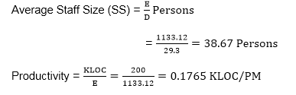
Examples
Hence E=3.0(200)1.12=1133.12PM D=2.5(1133.12)0.35=29.3PM
P = 176 LOC/PM

Slide 26
References
https://www.geeksforgeeks.org/software-engineering-cocomo-model/
https://www.javatpoint.com/cocomo-model
https://www.educba.com/cocomo-model/

Slide 27
THANK YOU

